Slide 1
File Management
Name: Jaimin Baurasi -202001403
sarvagn pathak - 202001258
Course: IT206
Course instructor: archana nigam

Slide 2
Problem statement:
File Handling is the storing of data in a file using a program. In Cpp programming language, the programs store results, and other data of the program to a file using file handling in Cpp. Also, we can extract/fetch data from a file to work with it in the program.
File handling in our day to day life can be used in many ways in programming like:
Student management
Shop market management
Bus management
Hotel management
Railway management
Hospital management
Thus, in every aspects of management we use file handling.
Here we have used file handling in shop market management to quickly calculate work seamlessly and efficiently so we would be using shop market management as an example of file handling.

Slide 3
Problem we faced:
It was very hard to carry out research.
We were getting problem to use data structure in file management because file management is a topic of input-output programs in cpp as they minimize the usage of array, stacks, linked list, queue, etc.
As there are many number of functions used in the program we faced difficulties calling out a functions in a decent manner.
We know that we were having some disadvantages of Linked list and we have to come up with the solution for the them
It requires more memory .
It was more time consuming as for accessing mode at any positions one has to traverse all the nodes before it.
It was more difficult to use random access linked list due to dynamic allocation.

Slide 4
Approach:
We used linked list as data structure to handle every data entered. It also regulates every product available in the shop or store which gives a much ease to the shop keeper managing products.
We have used Input-Output function in cpp which plays a crucial role in file handling.
We have used header files such as iostream, string, fstream, sstream.
We have tried to keep it as minimal as possible so that it doesn’t seem bulky and confusing to use.
Creating a new file Opening an existing file Reading data from an existing file
Writing data to a file Moving data to a specific location on the file
Closing the file

Slide 5
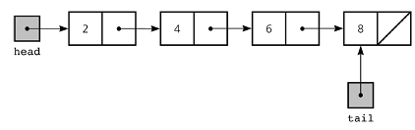
Data Structure we used : Linked List
Linked List can be defined as collection of objects called nodes that are randomly stored in the memory.
A node contains two fields i.e. data stored at that particular address and the pointer which contains the address of the next node in the memory.
The last node of the list contains pointer to the null.

Slide 6
We have used linked list data structure for saving the product id, name, quantity etc to store its values and we have used this data structure to make the time complexity less. With the advantage of linked list we can store as many as products and we can call the products for an immediate of time.
We have also used methods and algorithms for searching the elements, modifying the elements and placing the elements on the same node where it was replaced and operations like Insertion and deletion of the node which helps us to manage the file. We also have discount by using mathematical formulas to give discount or the developer can code for taxes also.
Linked list is a linear data structure where operation like insertion and deletion are easier than any other data structures. Also there is no wastage of memory as it uses dynamic memory allocation.
Also a disadvantage of linked is its traversal but here we are using the product id of the product for searching the element so that the compiler does not have to check each and every element.
We have used input output concept for saving it in a file.

Slide 7
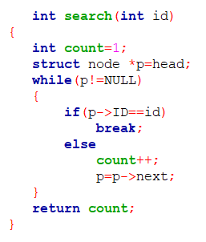
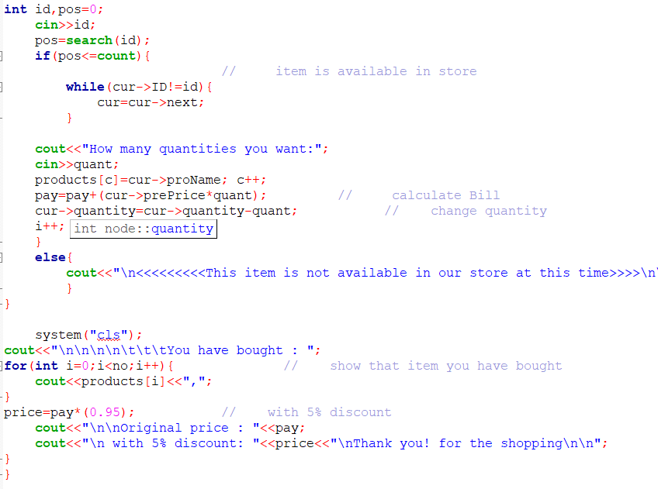
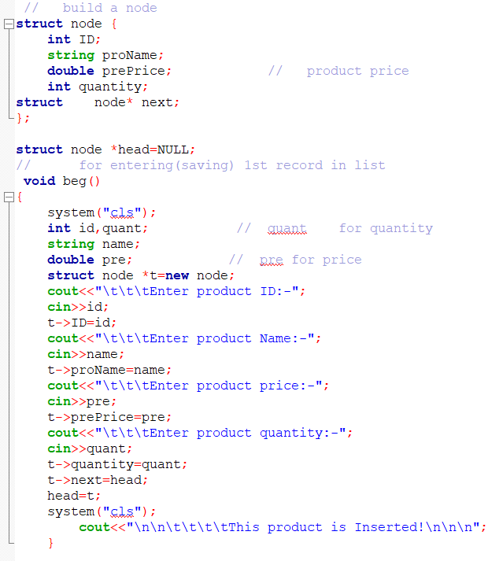
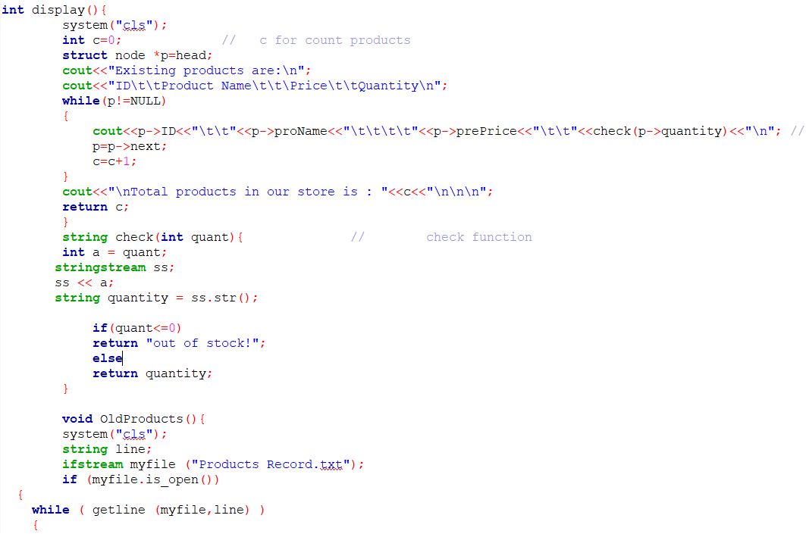
Some snippets of our code

Slide 8
Limitations:
On using different language could have made program more user friendly as well as more efficient.
It becomes hard for the customer to make changes in the program due lack of knowledge (user can’t even change the desired color of choice without knowing enough of programming).
It is very hard to keep up the maintenance.
It requires more and more complex algorithm for making it more efficient.

Slide 9
Learning
We learnt about color scheming which increases the aesthetics of the user interface.
Importance of color pallets
Palette Number | Three Colors
0 | LIGHTGREEN | LIGHTRED | YELLOW
1 | LIGHTCYAN | LIGHTMAGENTA | WHITE
2 | GREEN | RED | BROWN
3 | CYAN | MAGENTA | LIGHTGRAY

Slide 10
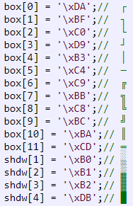
The borders are not transparent, but you can have a one or two line box frame, with or without shadows, with this program. Hopefully, you can use the parts you need you create your own program.

Slide 11
demo

